Slide 1


Project 3: Framingham Heart Study,
Analysis Plan
Joe Froelicher

Slide 2
Aims
Aim 1. Determine which risk factors are most associated with increased hazard of having a stroke
Aim 2. Analyze how much temporal change in the associated risk factors, and whether a more sophisticated temporal analysis is needed.
Goals:
Model the hazard of stroke
Determine significant covariates
Determine effects of time on covariates

Slide 3
Data
N=4434 particpants in period 1
N=4434-32=4402 participants without a previous stroke in period 1
N=111 occurrences of strokes in 10-year period (2.52%)
Risk factors:
age, systolic blood pressure, diastolic blood pressure, use of anti-hypertensive medication, current cigarette smoking, number of cigarettes per day, cholesterol, body mass index, glucose, diabetes status, heartrate

Slide 4
Analysis Plan: Aim 1
Analyze which factors are associated with the hazard (stroke)
Kaplan-Meier curve for each of men and women
Cox’s proportional hazards model with covariates
Use LASSO for Cox’s PH to select variables (risk factors)
Selected variables are the associated risk factors

Slide 5

Analysis Plan: Aim 2
Selected variables from Cox’s PH using LASSO
associated risk factors
Plots:
$\log\left(−log\left(S\left(t\right)\right)\right)$
Shoenfeld residuals
Add necessary interactions with time
Possibly, Temporal (longitudinal) generalized linear models
Outcome: associated risk factor
Predictor: time

Slide 6
Table 1: Descriptive statistics
 | Level | Censored | Stroke | Missing (%) | Overall
N |  | 4291 | 111 |  | 4402
Sex (%) | Men | 1881 (43.8) | 49 (44.1) | 0 | 1930
 | Women | 2410 (56.2) | 62 (55.9) | 0 | 2472
Cholesterol |  | 236.76 ± 44.59 | 246.83 ± 46.15 | 1.181 | 237.01 ± 44.65
Age |  | 49.7 ± 8.63 | 56.53 ± 7.37 | 0 | 49.88 ± 8.66
sBP |  | 132.1 ± 21.65 | 157.98 ± 31.62 | 0 | 132.76 ± 22.32
dBP |  | 82.73 ± 11.73 | 94.54 ± 16.32 | 0 | 83.03 ± 12.01
Smoke | No | 2175 (50.7) | 58 (52.3) | 0 | 2233
 | Yes | 2116 (49.3) | 53 (47.7) | 0 | 2169
Cigs/day |  | 8.99 ± 11.94 | 9.02 ± 12.58 | 0.704 | 8.99 ± 11.95
BMI |  | 25.8 ± 4.05 | 27 ± 4.91 | 0.386 | 25.83 ± 4.08
Diabetees | No | 4183 (97.5) | 100 (90.1) | 0 | 4283
 | Yes | 108 (2.5) | 11 (9.9) | 0 | 119
Medication | No | 4113 (97.1) | 93 (86.9) | 1.363 | 4266
 | Yes | 122 (2.9) | 14 (13.1) | 1.363 | 196
Heart Rate |  | 75.89 ± 12.12 | 76.72 ± 12.27 | 0.023 | 75.91 ± 12.13
Death | No | 2864 (66.7) | 13 (11.7) | 0 | 2877
 | Yes | 1427 (33.3) | 98 (88.3) | 0 | 1525
Time to Event (median) |  | 3650 ± 555.09 | 2144 ± 555.09 | 0 | 3650 ± 614.08

Slide 7
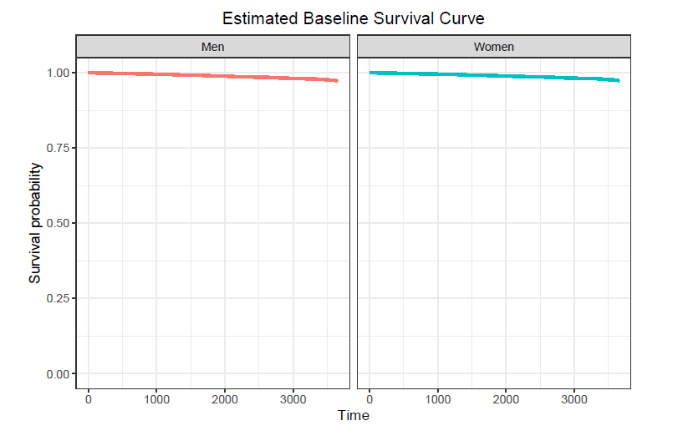

Slide 8

THANK YOU

